Slide 1

Pitch deck

Slide 2
About us
ADE’s AI is a team of people who aim to provide quality upscaling services to the masses through the use of modern AI technology which enhances the quality and overall reliability of upscaling technology.

Slide 3
Problem
The need for a tool that reduces the risk of quality reduction after upscaling an image.

Slide 4

Product overview
A product designed for ease of use and practicability

Slide 5
Problem solving
Market gap: There might be ways of solving our problem, but most come with a compromise we can solve.
Customers: Media and tech enthusiasts whose careers are specialized in the use of images as well as the casual participants in the field of media and communication can make use of our product.
Costs: inexpensive compared to some other AI based solutions.
Usability: customers want something easy to use that helps make their life easier

Slide 6
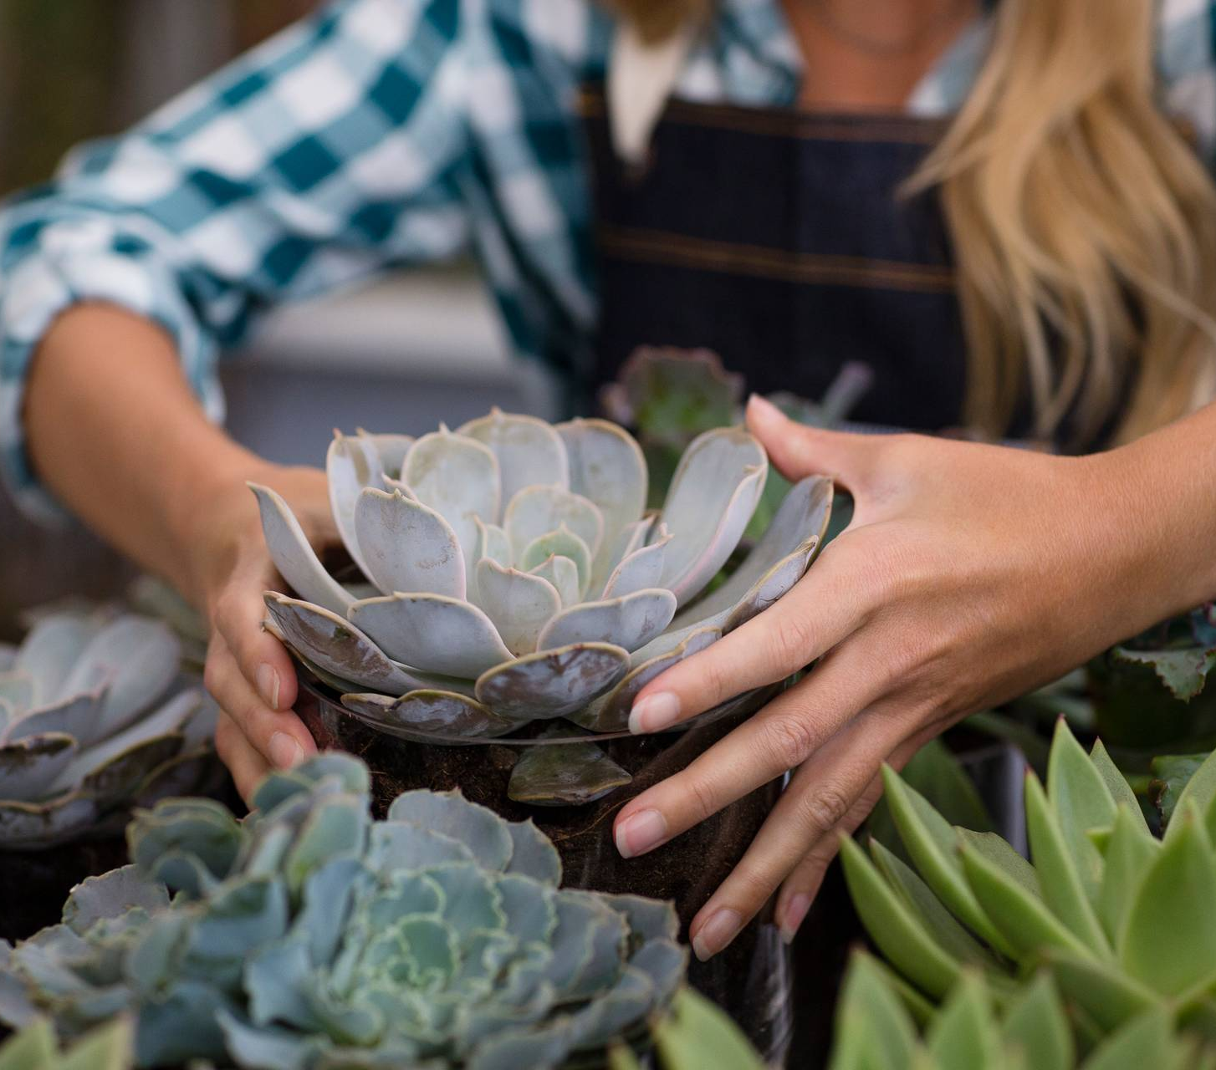
Product benefits
Ease of use and quick access

Slide 7
Product overview
Easy access
Tested
Authentic
Our product being an app means it is easy to access its features
Conducted testing using various images
Designed with the information sourced from experts in the field

Slide 8
Key features of ADE’S AI upscaler
Super resolution resampling: This means the AI makes use of resampling techniques that aid in pixel quality maintenance after upscaling such as the use of specialized interpolation techniques for image preservation.
Factor based scaling: This means factors are applied when upscaling to control how big the image becomes after upscaling.
Simple and friendly user interface: This means the user interface is easy to use and understand.

Slide 9
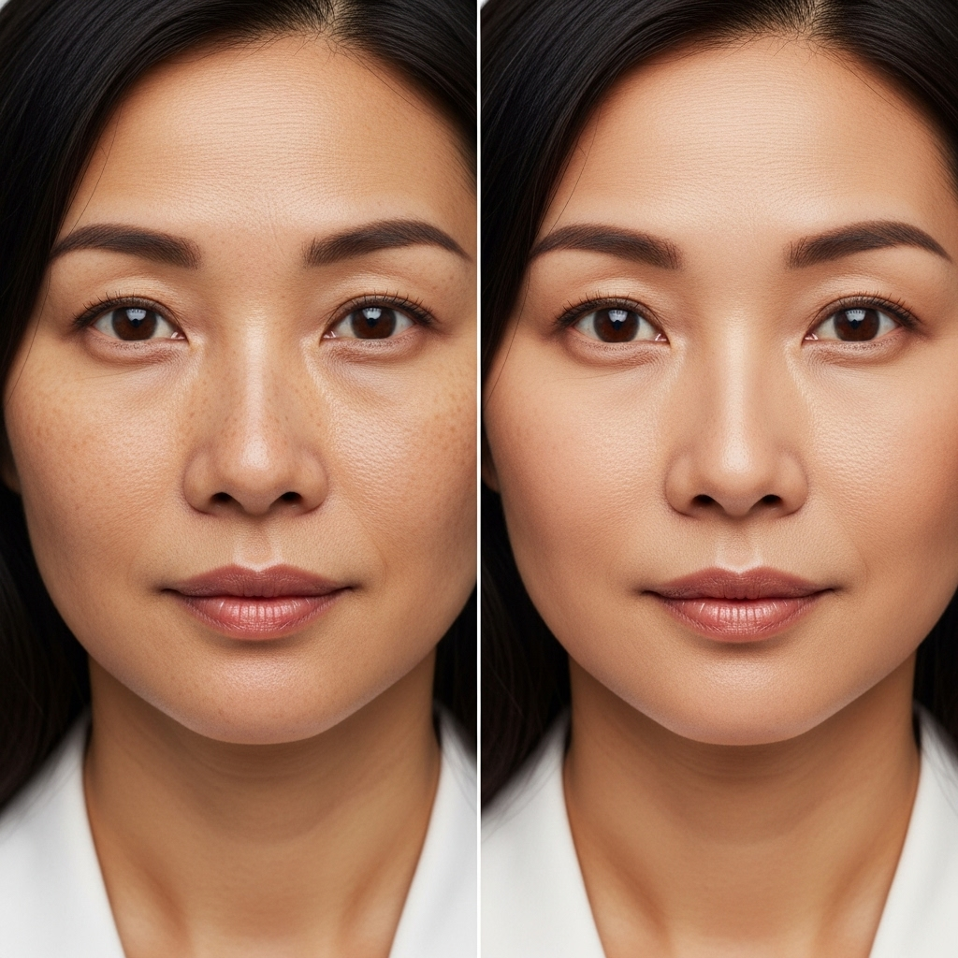
Difference between traditional rescaling and our AI enhanced upscaling
Look towards the two images to the left. The image on the left was traditionally rescaled while the image on the right was upscaled using AI.
“What ‘s the difference?” one may ask,
“They look the same” another may retort
Both pictures have the same source but there are differences although more minute, consider the contrast in the pixels the first picture has a darker contrast as a result of rescaling the pixels but the one on the right has a lighter contrast, as a result of AI enhanced interpolation techniques, which preserved the tone of the pixels giving the image on the right, a lighter contrast

Slide 10
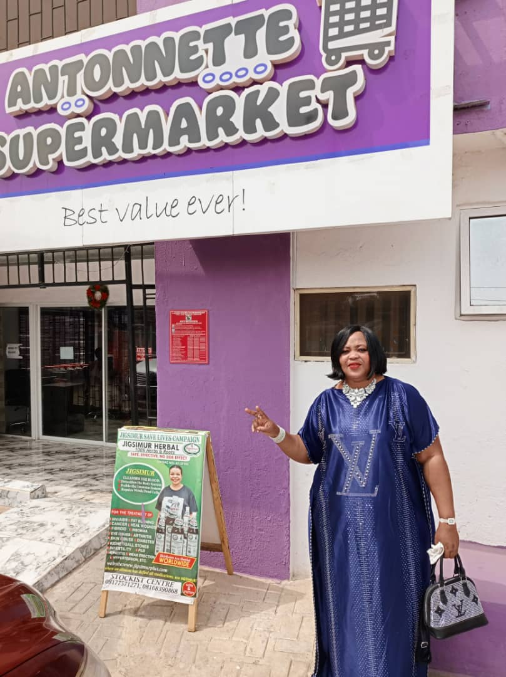
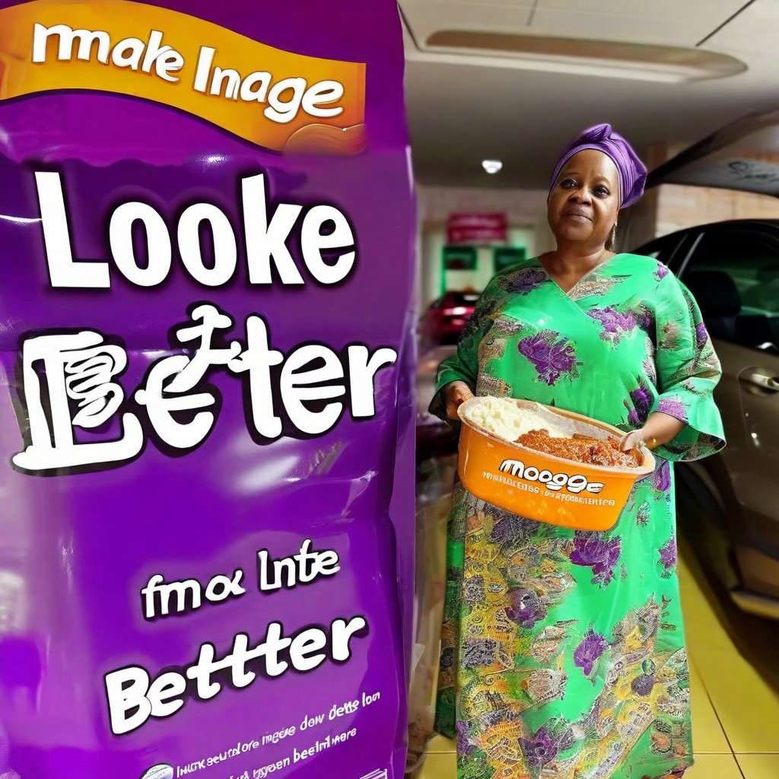
Typical Problems with upscaling
More AI’s than you would think can’t upscale images properly take for example amazon-nova-canvas-v1:0. This AI model is an image-to-image AI model, it possess functionalities pertaining to image generation, image variation(enhancing an already existing image), image editing etc. Now with these features, most will conclude it should be suitable model for image upscaling but that couldn't be far from the truth. Take these two images for instance, the one on the bottom is in fact the AI “upscaled” version of the image of the one on the right.

Slide 11
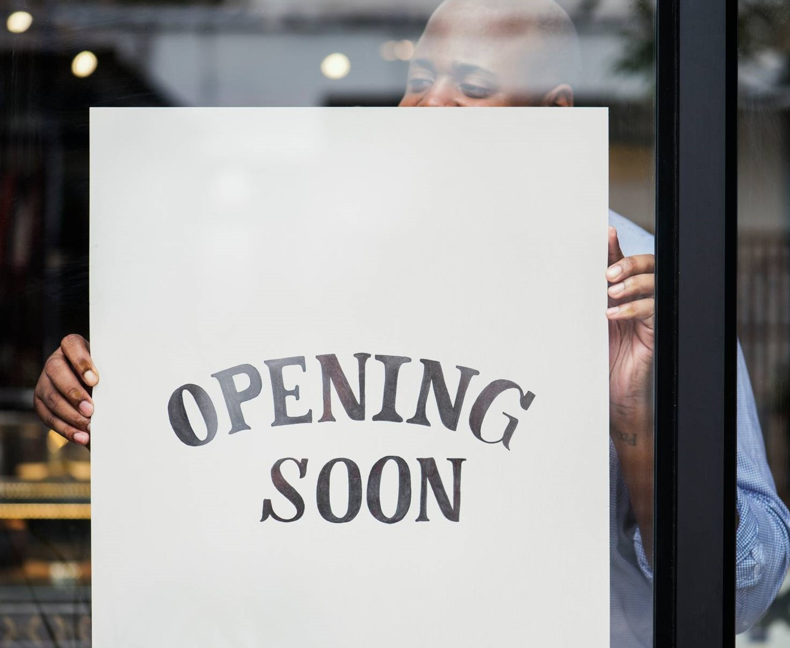
Growth strategy
Rolling out the product for beta testing to test the reliability of the product.
Release the product to the public and monitor press release and social media accounts
Gather feedback and adjust product design as necessary

Slide 12
Solution
Our product performs its task to the benefit of consumers,
Participants in the media and tech industry
Reduce expenses for replacement products
Simple design that gives customers the targeted information they need
Close the gap
Target audience
Cost savings
Easy to use

Slide 13
Thank you
Contact information:
Email:
eworitsewilliams883@gmail.com
anthony.agbonifo@pau.edu.ng
Phone number:
08080723545
09060546321
WhatsApp:
08097203368
09060546321

